Slide 1
Resolution in AI

Slide 2
Resolution
Conversion of facts into first-order logic.
Convert FOL statements into CNF
Negate the statement which needs to prove (proof by contradiction)
Draw resolution graph (unification).

Slide 3
Conversion of facts into first-order logic
John likes all kind of food.
Apple and vegetable are food
Anything anyone eats and not killed is food.
Anil eats peanuts and still alive
Harry eats everything that Anil eats.
Prove by resolution that:
John likes peanuts.

Slide 4
Cont…
1. Eliminate biconditionals and implications:
• Eliminate ⇔, replacing α ⇔ β with (α ....> β) ∧ (β …> α). •
Eliminate ⇒, replacing α …> β with ¬α ∨ β.
2. Move ¬ inwards: • ¬(∀ x p) ≡ ∃ x ¬p,
• ¬(∃ x p) ≡ ∀ x ¬p,
• ¬(α ∨ β) ≡ ¬α ∧ ¬β,
• ¬(α ∧ β) ≡ ¬α ∨ ¬β, • ¬¬α ≡ α.

Slide 5
Cont…
3. Standardize variables apart by renaming them: each quantifier should use a different variable.
4. Skolemize: each existential variable is replaced by a Skolem constant or Skolem function of the enclosing universally quantified variables.
• For instance, ∃x Rich(x) becomes Rich(G1) where G1 is a new Skolem constant.
• “Everyone has a heart” ∀ x P erson(x) ⇒ ∃ y Heart(y) ∧ Has(x, y) becomes ∀ x P erson(x) ⇒ Heart(H(x)) ∧ Has(x, H(x)), where H is a new symbol (Skolem function).

Slide 6
Cont…
5. Drop universal quantifiers
• For instance, ∀ x P erson(x) becomes P erson(x).
6. Distribute ∧ over ∨: • (α ∧ β) ∨ γ ≡ (α ∨ γ) ∧ (β ∨ γ).

Slide 7
Convert FOL statements into CNF
Eliminate all implication (→) and rewrite
∀x ¬ food(x) V likes(John, x)
food(Apple) Λ food(vegetables)
∀x ∀y ¬ [eats(x, y) Λ ¬ killed(x)] V food(y)
eats (Anil, Peanuts) Λ alive(Anil)
∀x ¬ eats(Anil, x) V eats(Harry, x)
∀x¬ [¬ killed(x) ] V alive(x)
∀x ¬ alive(x) V ¬ killed(x)
likes(John, Peanuts).

Slide 8
Move negation (¬)inwards and rewrite
∀x ¬ food(x) V likes(John, x)
food(Apple) Λ food(vegetables)
∀x ∀y ¬ eats(x, y) V killed(x) V food(y)
eats (Anil, Peanuts) Λ alive(Anil)
∀x ¬ eats(Anil, x) V eats(Harry, x)
∀x ¬killed(x) ] V alive(x)
∀x ¬ alive(x) V ¬ killed(x)
likes(John, Peanuts).

Slide 9
Rename variables or standardize variables
∀x ¬ food(x) V likes(John, x)
food(Apple) Λ food(vegetables)
∀y ∀z ¬ eats(y, z) V killed(y) V food(z)
eats (Anil, Peanuts) Λ alive(Anil)
∀w¬ eats(Anil, w) V eats(Harry, w)
∀g ¬killed(g) ] V alive(g)
∀k ¬ alive(k) V ¬ killed(k)
likes(John, Peanuts).

Slide 10
Eliminate existential instantiation quantifier by elimination.
In this step, we will eliminate existential quantifier ∃, and this process is known as Skolemization.
But in this example problem since there is no existential quantifier so all the statements will remain same in this step.

Slide 11
Drop Universal quantifiers
In this step we will drop all universal quantifier since all the statements are not implicitly quantified so we don't need it.
¬ food(x) V likes(John, x)
food(Apple)
food(vegetables)
¬ eats(y, z) V killed(y) V food(z)
eats (Anil, Peanuts)
alive(Anil)
¬ eats(Anil, w) V eats(Harry, w)
killed(g) V alive(g)
¬ alive(k) V ¬ killed(k)
likes(John, Peanuts).

Slide 12
Negate the statement to be proved
In this statement, we will apply negation to the conclusion statements, which will be written as
¬likes(John, Peanuts)

Slide 13
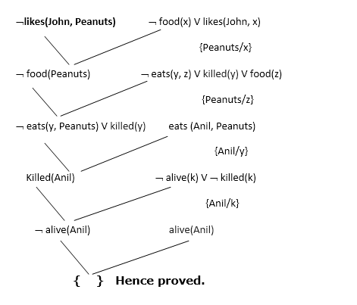
Draw Resolution graph

Slide 14
Cont…
In the first step of resolution graph, ¬likes(John, Peanuts) , and likes(John, x) get resolved(canceled) by substitution of {Peanuts/x}, and we are left with ¬ food(Peanuts)
In the second step of the resolution graph, ¬ food(Peanuts) , and food(z) get resolved (canceled) by substitution of { Peanuts/z}, and we are left with ¬ eats(y, Peanuts) V killed(y) .
In the third step of the resolution graph, ¬ eats(y, Peanuts) and eats (Anil, Peanuts) get resolved by substitution {Anil/y}, and we are left with Killed(Anil) .
In the fourth step of the resolution graph, Killed(Anil) and ¬ killed(k) get resolve by substitution {Anil/k}, and we are left with ¬ alive(Anil) .
In the last step of the resolution graph ¬ alive(Anil) and alive(Anil) get resolved.

